Slide 1


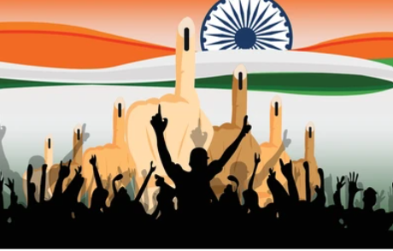

VISUALIZING ELECTION DATA FOR A NEWS COMPANY
BY TEAM 1 :
DIVYA
ANJALI
ABHISHEK
ASMITHA
JANNATH

Slide 2
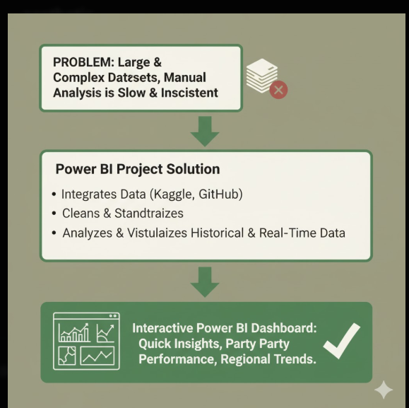
INTRODUCTION
Elections produce large and complex datasets with details on candidates, parties, constituencies, votes, turnout, and demographics. Analyzing this manually is slow and often inconsistent.
To address these challenges ,this project builds a Power BI dashboard that integrates, analyzes, and visualizes both historical and real-time election data. It helps users quickly understand party performance, voter participation, and regional trends through an interactive and easy-to-use platform.

Slide 3




OBJECTIVES & GOALS
Integrate and standardize multi-year election datasets at national and state levels.
Analyze and present vote share trends, voter turnout, and demographic patterns.
Develop a scalable, reusable dashboard for future elections and datasets.
Enable real-time visualization of election results and key performance metrics.
Provide in-depth insights into party and candidate performance.

Slide 4




DATA ACQUISITION
Collected verified, publicly available datasets: Indian Election Dataset (Kaggle), Parliament Election Data (GitHub), and Lok Sabha 2024 Results (Kaggle).
Ensured accuracy and diversity by consolidating multiple sources.
Performed initial cleaning and standardization for seamless Power BI integration.

Slide 5
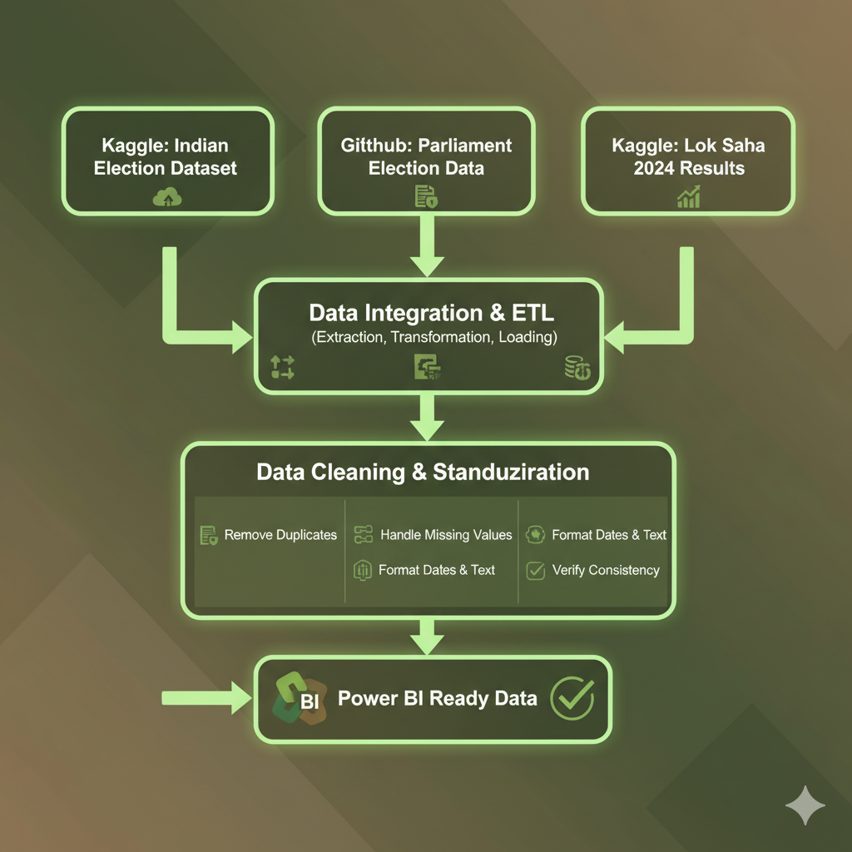

DATA INTEGRATION & CLEANING
Cleaned and standardized datasets to remove inconsistencies, duplicates, and missing values.
Integrated multiple datasets via API connections, creating a unified dataset for analysis.
Ensured the data structure supported both historical trends and real-time simulation.

Slide 6
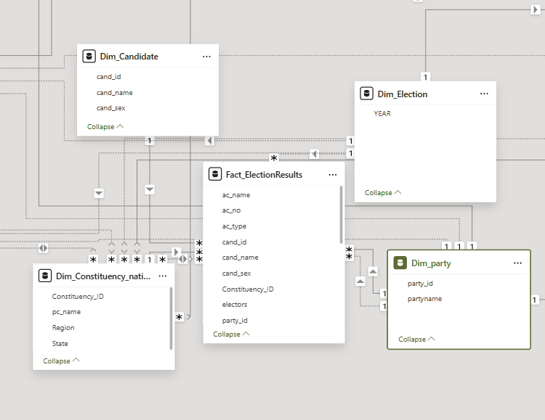
DATA MODELLING & STAR SCHEMA
Implemented a Star Schema with ElectionResults as the Fact Table and Candidate, Constituency, Party, and Year as Dimension Tables.
Created calculated columns and DAX measures: Vote %, Margin %, Turnout %.
Defined relationships for drill-downs, cross-filtering, and interactive dashboard analysis.

Slide 7






DASHBOARD OVERVIEW
Historical Trends – Multi-year analysis of vote share and turnout.
Demographics – Insights by gender, age, and region.
Real-Time Results – Live tracking of parties, seats, and margins.
Party & Candidate Insights – Detailed performance breakdowns.

Slide 8
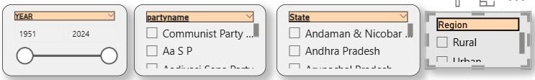

Slicers & KPIs Overview
Integrated interactive slicers for Year, Party Name, State, and Region to enable flexible data exploration.
Designed top-level KPIs showing real-time metrics:
Total Seats Won
Total Votes Counted
Turnout Percentage

Slide 9
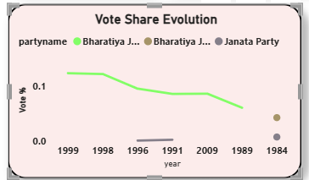
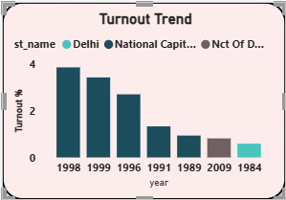
Historical Trends
Shows how vote share and turnout changed over the years, revealing shifts in party performance and voter engagement.
Vote Share %: Party popularity trends over time.
Turnout %: Tracks voter participation levels.
Visualization: Line & bar charts for year-wise comparison.

Slide 10
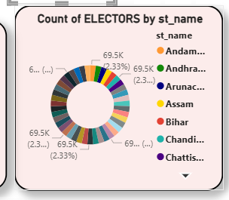
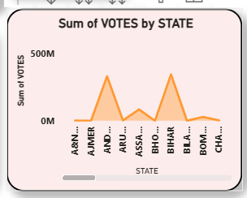
State-Level Insights
This section focuses on understanding how votes and electors are distributed across different states to identify key regions of voter concentration and performance.
Sum of Votes by State: Highlighted states with high and low voter turnout to show regional variations.
Count of Electors by State (Donut Chart): Showed proportional representation of electors across states for easy comparison

Slide 11
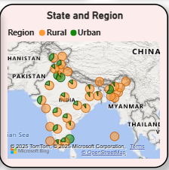
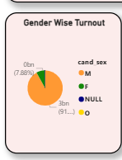
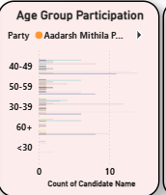
Demographic Insights
This section focuses on analyzing voter behavior across demographics to understand how population traits influence election outcomes.
Gender-wise Turnout: Analyzed male and female participation to identify regional differences.
Age Group Participation: Analyzed voter participation across different age groups to identify generational engagement patterns..
Urban vs. Rural Participation: Examined voting patterns to highlight geographic influences on overall turnout.

Slide 12
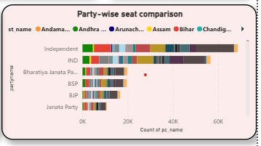
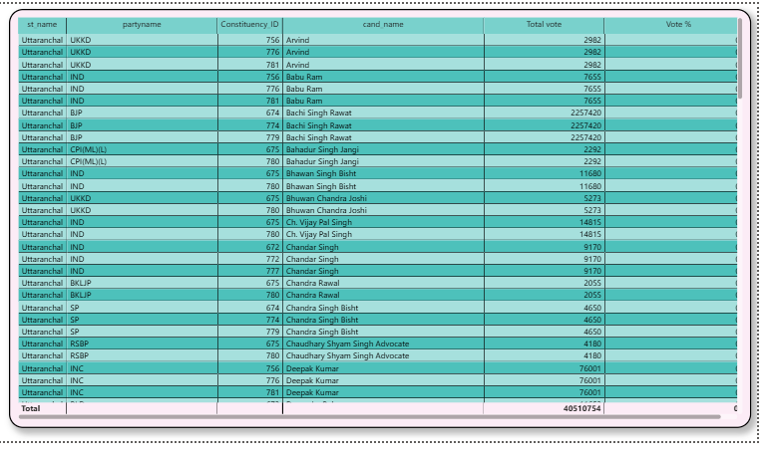
Party & Candidate
Performance Overview
This section highlights how different parties and candidates performed across states, focusing on both overall and detailed results.
Party-wise Seat Comparison: Showed the competitive performance of major parties.
Detailed Data Table: Included State, Party, Candidate, Constituency, Total Votes, and Vote % for deeper analysis.

Slide 13
CONCLUSION
A unified and interactive Power BI dashboard was developed to integrate election data from multiple verified sources into a single, cohesive platform. It ensures consistency, accuracy, and ease of analysis across datasets.
The dashboard provides clear insights into historical trends, demographics, real-time updates, and candidate performance, enabling quick and visual understanding of election outcomes.

Slide 14
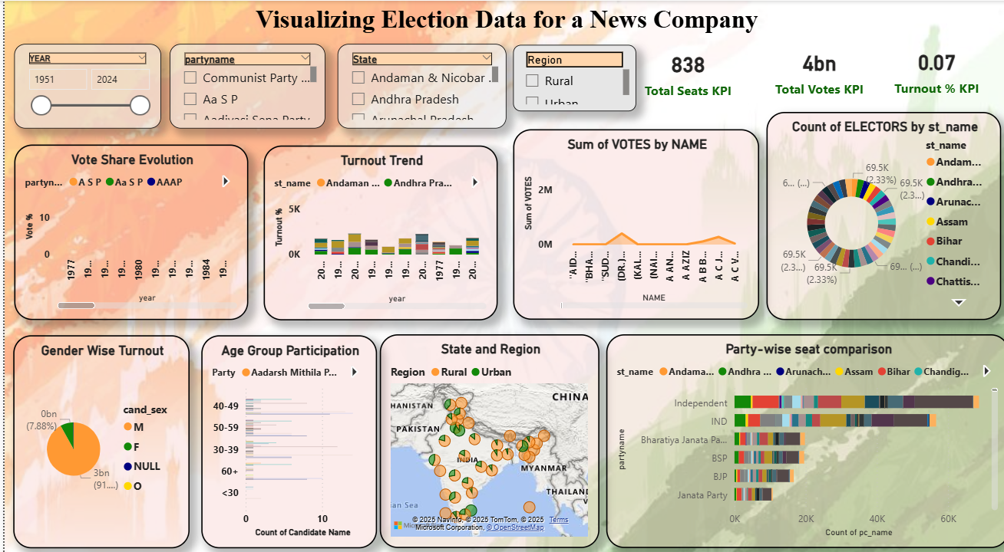
DASHBOARD

Slide 15

THANKYOU

